Slide 1

Programming Python
A blitz through some programming concepts

Slide 2
Programming
A way of thinking
Definitions
Python
Variables Objects Types
Logic
Practice & Examples

Slide 3
Programming
Environment
Installed on the computer
10100101 -> 100010101010011110
Language
Installed in the human
These words and symbols, when put together have meaning to the computer

Slide 4

Programming
Programming is a way of thinking, not a rote skill.
People understand what they can see. If a programmer cannot see what a program is doing, he/she can't understand it.
Notes:
Learning about "for" loops is not learning to program, any more than learning about pencils is learning to draw.

Slide 5
Programming
read the vocabulary
what do these words mean?
follow the flow
what happens when?
see the state
what is the computer thinking?
create by abstracting
start concrete, then generalize
Notes:
Should allow you to

Slide 6
Perl?
$_[0]=eval<>;
for(0..$#{$_[0]}**2){
@_[$#_+1]=[\(@{$_[$#_]}),$#{$_[$#_]}+1];
for(1..$#{$_[$#_]}-$#_){
if(eval('${'x$#_.'@{$_[$#_]}[$_-1]'.'}'x$#_)>eval('${'x$#_.'@{$_[$#_]}[$_]'.'}'x$#_)){
${$_[$#_]}[$#{$_[$#_]}]=$_;
}
}
(${$_[$#_]}[${$_[$#_]}[$#{$_[$#_]}]-1],${$_[$#_]}[${$_[$#_]}[$#{$_[$#_]}]])=(${$_[$#_]}[${$_[$#_]}[$#{$_[$#_]}]],${$_[$#_]}[${$_[$#_]}[$#{$_[$#_]}]-1]);
}
for(0..~~@{$_[0]}){
$\.=eval('${'x$#_.'${$_[$#_]}[$_-1]'.'}'x$#_).','
}
$\=~s/,*$//;$\=~s/^,*//;$\="[$\]";
print;

Slide 7
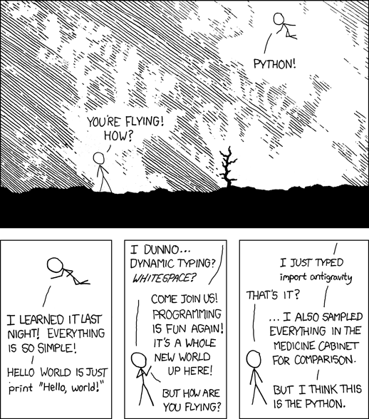
Why Python?
Powerful object oriented features
Great for text processing
Useful object types
Clean syntax
Powerful extensions
Large and active community
numpy/scipy/biopython

Slide 8

The Zen of Python
by Tim Peters
Explicit is better than implicit.
Simple is better than complex.
In the face of ambiguity, refuse the temptation to guess.
There should be one-- and preferably only one --obvious way to do it.

Slide 9
Some useful python distributions
http://www.python.org/
Reference implementation with standard libraries, that’s it!
anaconda
Pre-packaged scientific goodies
Paid version with extras
http://continuum.io/downloads
enthought canopy
Pre-packaged scientific goodies
Integrated IDE/package manager
Paid version with extras (free for academics)
pythonxy
Windows only
Many scientific computing goodies
https://code.google.com/p/pythonxy/

Slide 10
Some useful python environments
Komodo Edit
http://www.activestate.com/komodo-edit
PyCharm
http://www.jetbrains.com/pycharm/
PythonTutor
http://www.pythontutor.com

Slide 11
Object Oriented Programming
Objects hold information
They can contain values
They can contain multiple values
They can contain other objects
They have types
They can inherit information from others

Slide 12
Some Python Object Types
Numbers
Integers (whole numbers): 7
Floating point numbers: 7.7
String
Sequence of characters: “word!”
Set
Unordered and unique collection of objects

Slide 13
Some Python Object Types
List
An ordered list of objects:
[2, 4, 7, 22]
[“acgta”, “gtaagt”]
Dictionary
“associative arrays”
A collection of key -> values
{“age”:13, “address”: “123 street”}

Slide 14
Programming Logic
If/else
Conditional logic!
Allows you to control the flow of behavior
If it rains today I will bring an umbrella
if raining == true:
bring_umbrella()
elif snowing == true:
wear_snowboots()
else:
rock_sunglasses()

Slide 15
Programming Logic
For or while loops
Do something several times
Make sure you understand when or if things stop!
while ben == “awesome”:
dance_like_its_1999()
for dance_move in list_of_dance_moves:
dance(dance_move)

Slide 16
Functions
Modularized sets of instructions you can re-use
Mini-programs
Do something or return an object
run_pcr(DNA_source=“”,
program=touchdown,
forward_primer=“ITS1-F”,
forward_primer=“ITS1-R”)

Slide 17
Namespaces (“Frames”)
Abstract container for your objects
Context for names of things
Analogy: file and folder names

Slide 18
Interactive tutorial
http://bit.ly/1iPEg4M

Slide 19
Group assignment
Write a python script that outputs the numbers 1 to 30

Slide 20
Group assignment
Write a python script that outputs the numbers 1 to 30, replacing any number divisible by 3 with the word “evolution”

Slide 21
Group assignment
Write a python script that outputs the numbers 1 to 30, replacing any number divisible by 3 with the word “evolution” and any number divisible by 5 with the word “ecology”

Slide 22
My solution
for number in range(1,31):
if number % 15 == 0:
out = "evolution and ecology"
elif number % 3 == 0:
out = "evolution"
elif number % 5 == 0:
out = "ecology"
else:
out = str(number)
print(out)

Slide 23

Can parse data files into Python
Blast output, fasta, GenBank, Etc
Interfaces to common programs
Blast, clustalw, EMBOSS, phylip, genepop
Some built-in functions for manipulation
Extensive documentation
http://biopython.org/DIST/docs/tutorial/Tutorial.html

Slide 24
Fastq q/c pt 1
#!/usr/bin/env python
from Bio import SeqIO
#set an average quality score cutoff
qual_cutoff = 25
#initialize the file handle
file_handle = open("fastqs/Chip2comb_001b.fastq", "r")
#initialize fastq file parser
fastq_file = SeqIO.parse(file_handle, "fastq")

Slide 25
Fastq q/c pt 2
for record in fastq_file:
#sum of quality scores divided by the length
avg_qual = sum(record.letter_annotations["phred_quality"]) /
len(record)
#if the read is of sufficient average quality
if avg_qual > qual_cutoff:
#print it in fastq format
print record.format("fastq")

Slide 26
Histogram of sequence lengths
#!/usr/bin/env python
import sys
from Bio import SeqIO
from matplotlib import pyplot as plt
sizes = [len(rec) for rec in SeqIO.parse(sys.argv[1], "fasta")]
plt.hist(sizes, bins=50)
plt.title("{} orchid sequences\nLengths {} to {}".format(
len(sizes), min(sizes), max(sizes)))
plt.xlabel("Sequence length (bp)")
plt.ylabel("Count")
plt.show()

